Slide 1

SUMMER INTERNSHIP
Data Science with Python
Beeskilled
Vikram Adhikari
Roll No.: 25SCS1003004887 | Semester III | Section: 2CSE11
B.Tech (CSE) | IILM University, Greater Noida | Batch: 2026–27

Slide 2
OVERVIEW
Internship Overview
ORGANIZATION
Beeskilled
DOMAIN
Data Science with Python
MODE
Online Internship
DURATION
13 July 2026 – 24 August 2026
OBJECTIVE
Develop practical skills in Python-based data analysis, visualization, and introductory machine learning.
2

Slide 3
OBJECTIVES
Internship Objectives
Understand Data Science using Python.
Work with datasets using Pandas and NumPy.
Perform data cleaning, preprocessing and statistical analysis.
Create visualizations using Matplotlib and Seaborn.
Perform Exploratory Data Analysis (EDA).
Understand introductory Machine Learning and Linear Regression.
Apply learned skills to a complete final project.
3

Slide 4
TOOLCHAIN
Technologies & Tools
Python
primary programming language
Pandas
data loading, cleaning and analysis
NumPy
numerical operations
Matplotlib
data visualization
Seaborn
statistical and categorical visualization
Scikit-learn
introductory machine learning and Linear Regression
Google Colab
notebook environment for the final Titanic project
4

Slide 5
WEEK 1
Week 1 – Python for Data Science
Module: Python for Data Science Basics & Student Marks Analysis
Introduction to Python for Data Science.
Worked with Pandas and NumPy.
Used the Student Marks Dataset.
Performed basic data cleaning and statistical calculations.
Analyzed basic data properties and results.
5

Slide 6
WEEK 2
Week 2 – Data Visualization & EDA
Module: Data Visualization & Exploratory Data Analysis
Worked with the COVID-19 Dataset.
Used Matplotlib and Seaborn for visualization.
Created trend plots and country comparisons.
Used heatmaps and scatter plots to explore patterns and relationships.
6

Slide 7
WEEK 3
Week 3 – Machine Learning
Module: Machine Learning & Student Performance Prediction
Introduction to Machine Learning using Scikit-learn.
Worked with the Student Performance Dataset.
Performed data preparation and model training.
Applied Linear Regression.
Evaluated the trained model.
7

Slide 8
WEEK 4
Week 4 – Final Project
Final Project: Titanic Dataset Analysis | Platform: Google Colab
Loaded and inspected the Titanic Dataset.
Handled missing values and prepared the data.
Created AgeGroup and FamilySize features.
Analyzed survival patterns using grouped statistics and visualizations.
8

Slide 9
TITANIC PROJECT
Titanic Dataset – Data Preprocessing
Dataset contained 891 passenger records.
Missing Age values were replaced using the median.
Cabin was removed because most values were missing.
Missing Embarked values were filled using the mode.
Created AgeGroup using defined age ranges.
Created FamilySize = SibSp + Parch + 1.
9

Slide 10
TITANIC PROJECT
Titanic Analysis – Overall Results
891
342
549
38.38%
61.62%
TOTAL PASSENGERS
SURVIVED
DID NOT SURVIVE
OVERALL SURVIVAL RATE
OVERALL DEATH RATE
Survival was compared by gender, class, age, embarkation point and family size.
10

Slide 11
TITANIC PROJECT
Titanic Analysis – Key Findings
BY GENDER
BY CLASS
BY AGE GROUP
BY EMBARKATION
Female
1st Class
Child
Cherbourg
74.20%
62.96%
57.97%
55.36%
Male
2nd Class
Teenager
Queenstown
18.89%
47.28%
42.86%
38.96%
Young Adult
3rd Class
35.33%
Southampton
24.24%
Adult
33.90%
40.00%
Senior
22.73%
Family size 4: highest observed survival rate at 72.41%.
11

Slide 12
PROCESS
Data Science Workflow
Data Collection
→
Data Loading
→
Data Cleaning
→
Exploratory
Data Analysis
→
Visualization
→
Analysis
→
Results &
Interpretation
The internship progressively developed skills from basic data analysis to visualization, machine learning and final-project interpretation.
12

Slide 13
OUTCOMES
Skills Gained
Python programming for Data Science
Data cleaning and preprocessing
Exploratory Data Analysis
Statistical and grouped analysis
Data visualization
Machine Learning fundamentals
Linear Regression using Scikit-learn
Practical use of Google Colab
Data interpretation and presentation
13

Slide 14
CLOSING
Conclusion
The internship provided practical exposure to the basic Data Science workflow.
Project-based learning connected Python concepts with real datasets.
The Titanic project brought together data cleaning, feature creation, analysis and visualization.
The internship strengthened practical analytical and problem-solving abilities.
The actual Titanic notebook will be uploaded separately to GitHub as supporting evidence.
14

Slide 15
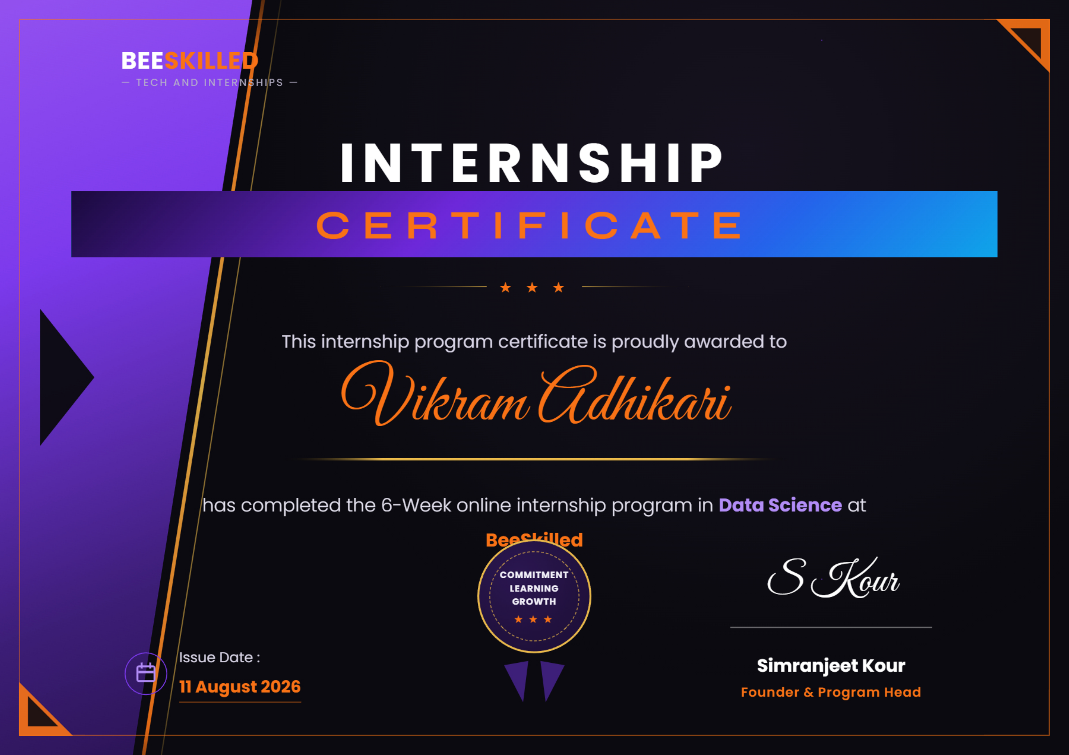
Certification & Official Verification
14

Slide 16
THANK YOU
Vikram Adhikari
25SCS1003004887 | 2CSE11
Data Science with Python – Beeskilled

